Slide 1
Visual Analytics: Intro to HTML, CSS, and JavaScript
Ab Mosca (they/them)

Slide 2
Today’s plan
Front end web development for visualization:
Modeling a webpage
Creating a webpage
Styling a webpage
Adding interaction to a webpage

Slide 3
Modeling a webpage
Go to: smith.edu
Right click anywhere, select “inspect” from the menu
Start on the “Elements” pane of the inspection panel, explore the webpage
How do you think this webpage is made?

Slide 4
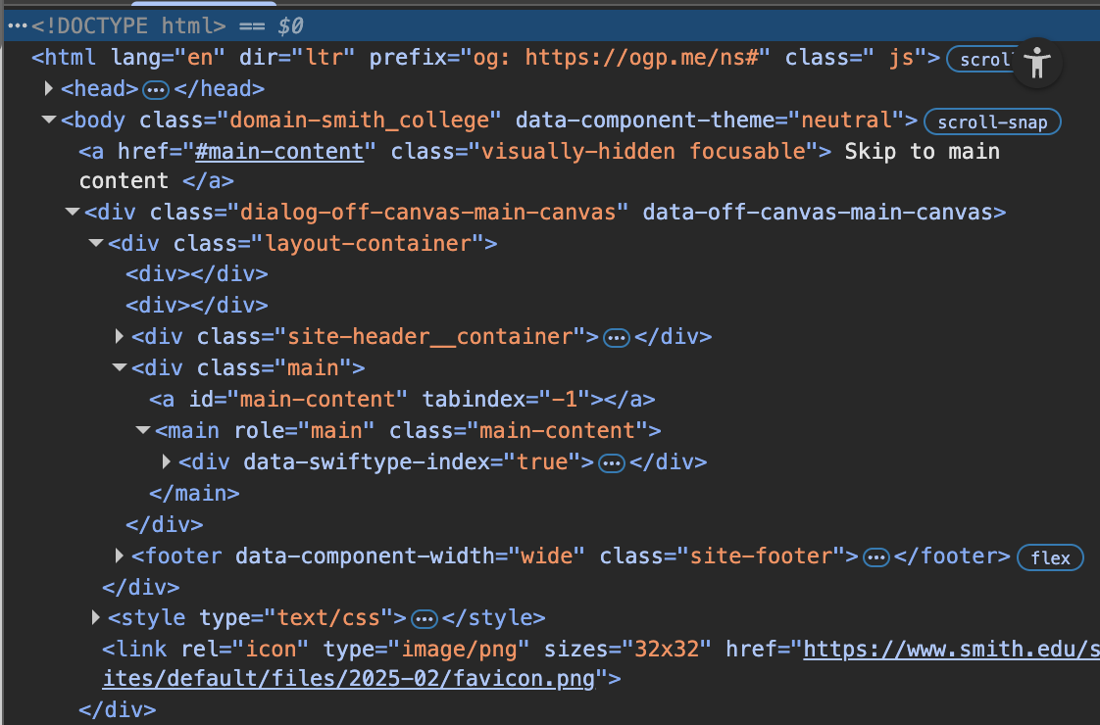
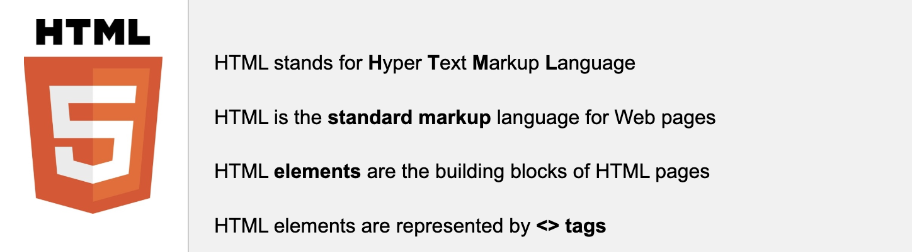
Modeling a webpage
A webpage is defined through HTML
https://www.w3schools.com/whatis/whatis_html.asp

Slide 5
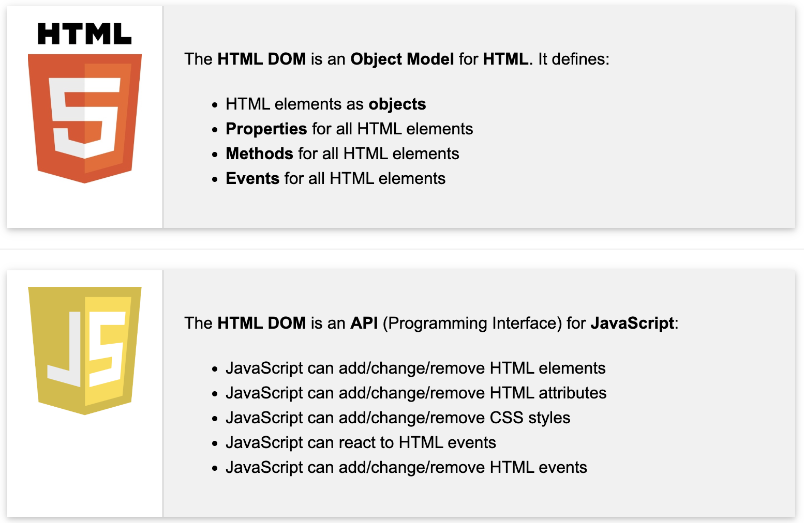
Modeling a webpage
DOM = Document Object Model
When a webpage is loaded, the browser (ex. Chrome) creates a DOM of the page
The DOM model of a webpage is a tree of HTML objects
https://www.w3schools.com/whatis/whatis_htmldom.asp

Slide 6

Modeling a webpage
DOM = Document Object Model
When a webpage is loaded, the browser (ex. Chrome) creates a DOM of the page
The DOM model of a webpage is a tree of HTML objects
https://www.w3schools.com/whatis/whatis_htmldom.asp

Slide 7
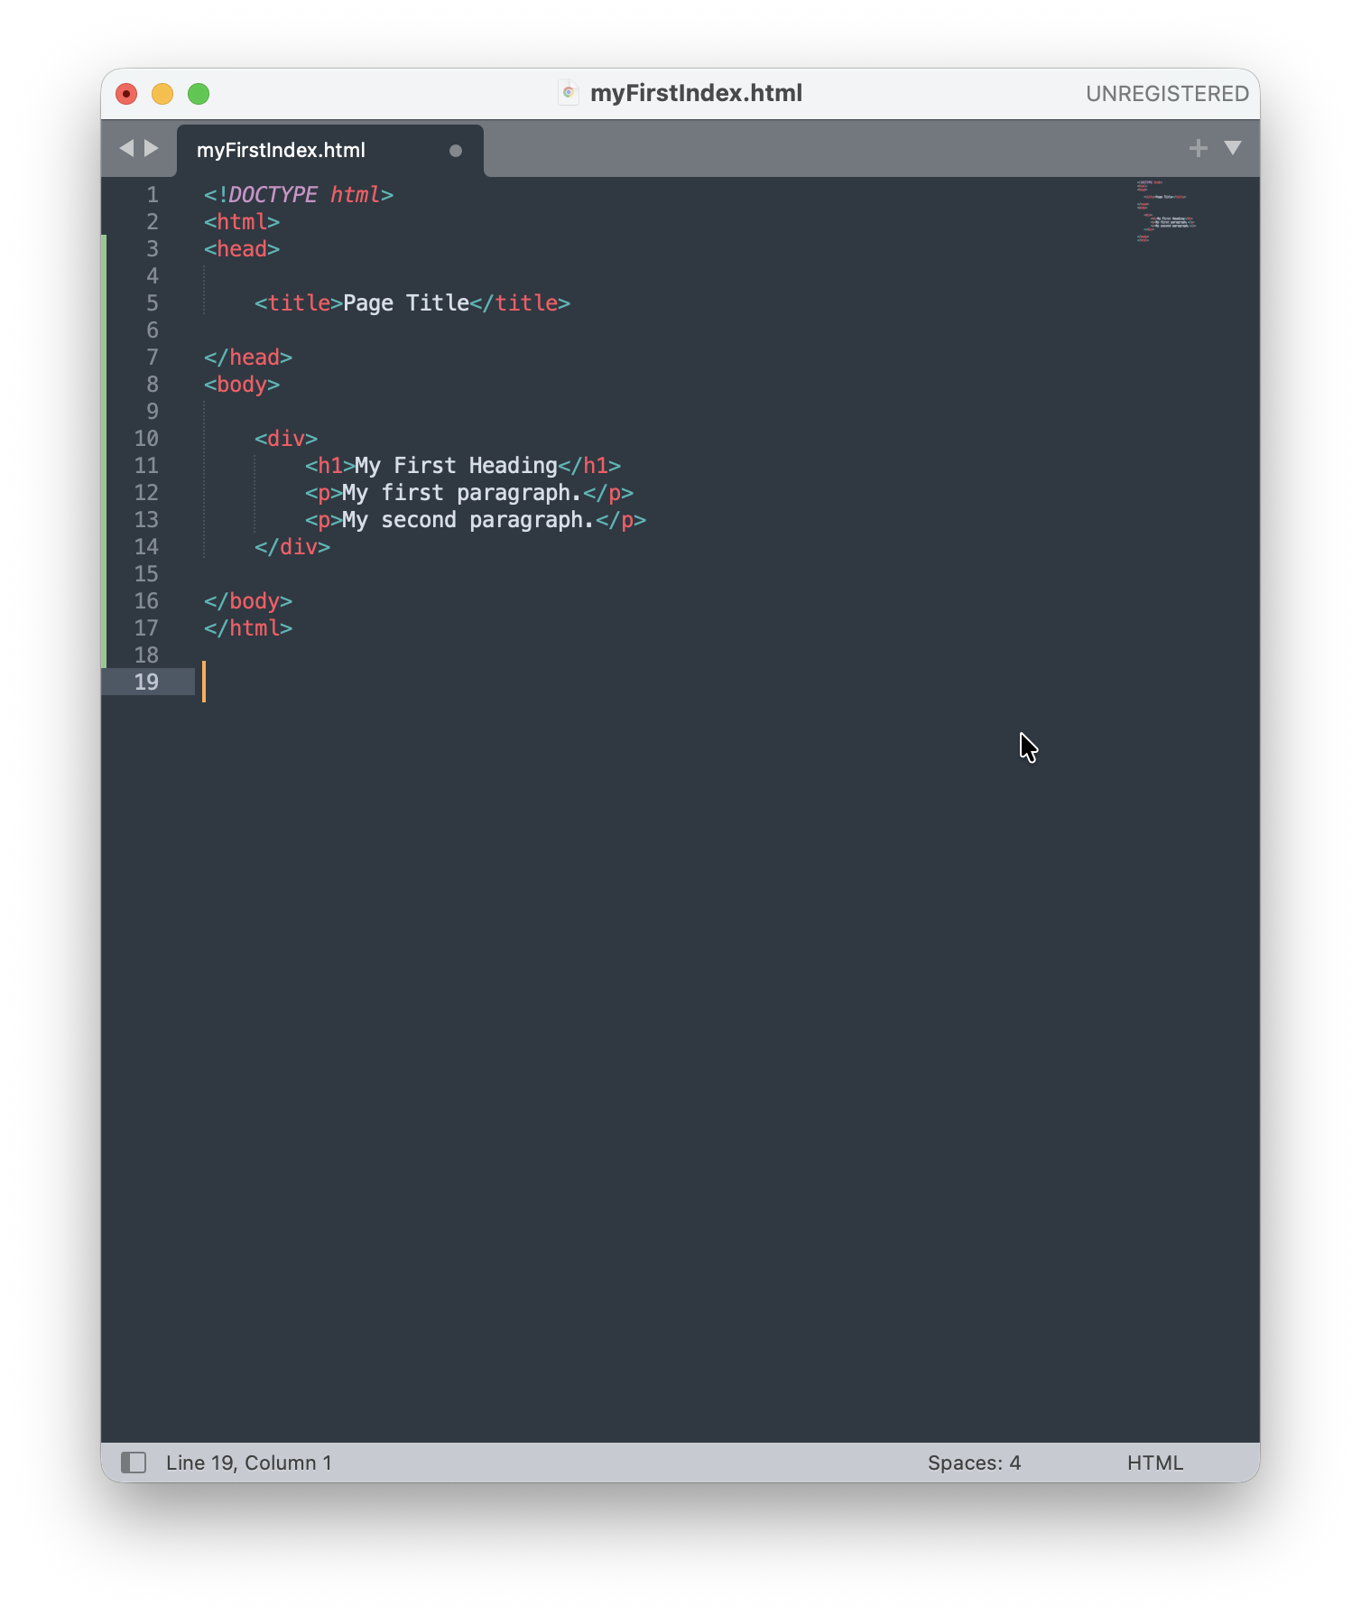
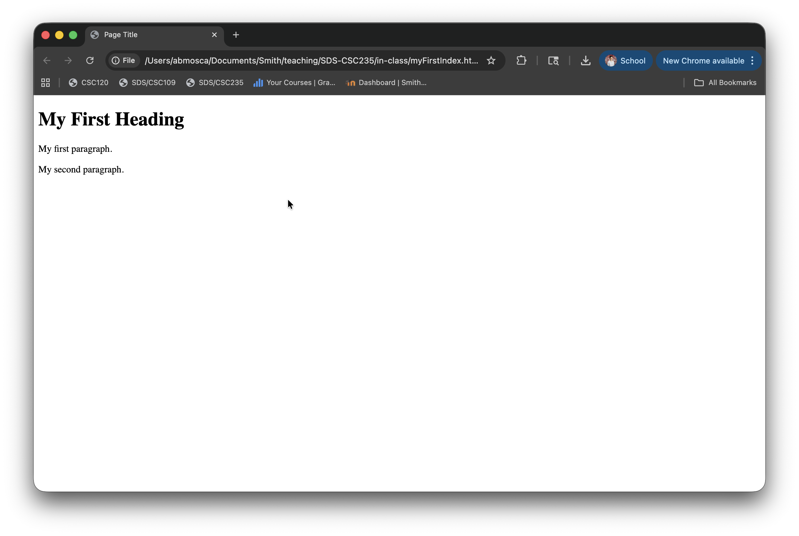
Building a webpage: HTML
https://www.w3schools.com/html/html_intro.asp

Slide 8
Building a webpage: HTML
Document
<head>
<body>
<title>
Text: Page Title
<div>
<h1>
Text: My First Heading
<p>
Text: My first paragraph.
<p>
Text: My second paragraph.
<html>
https://www.w3schools.com/html/html_intro.asp

Slide 9
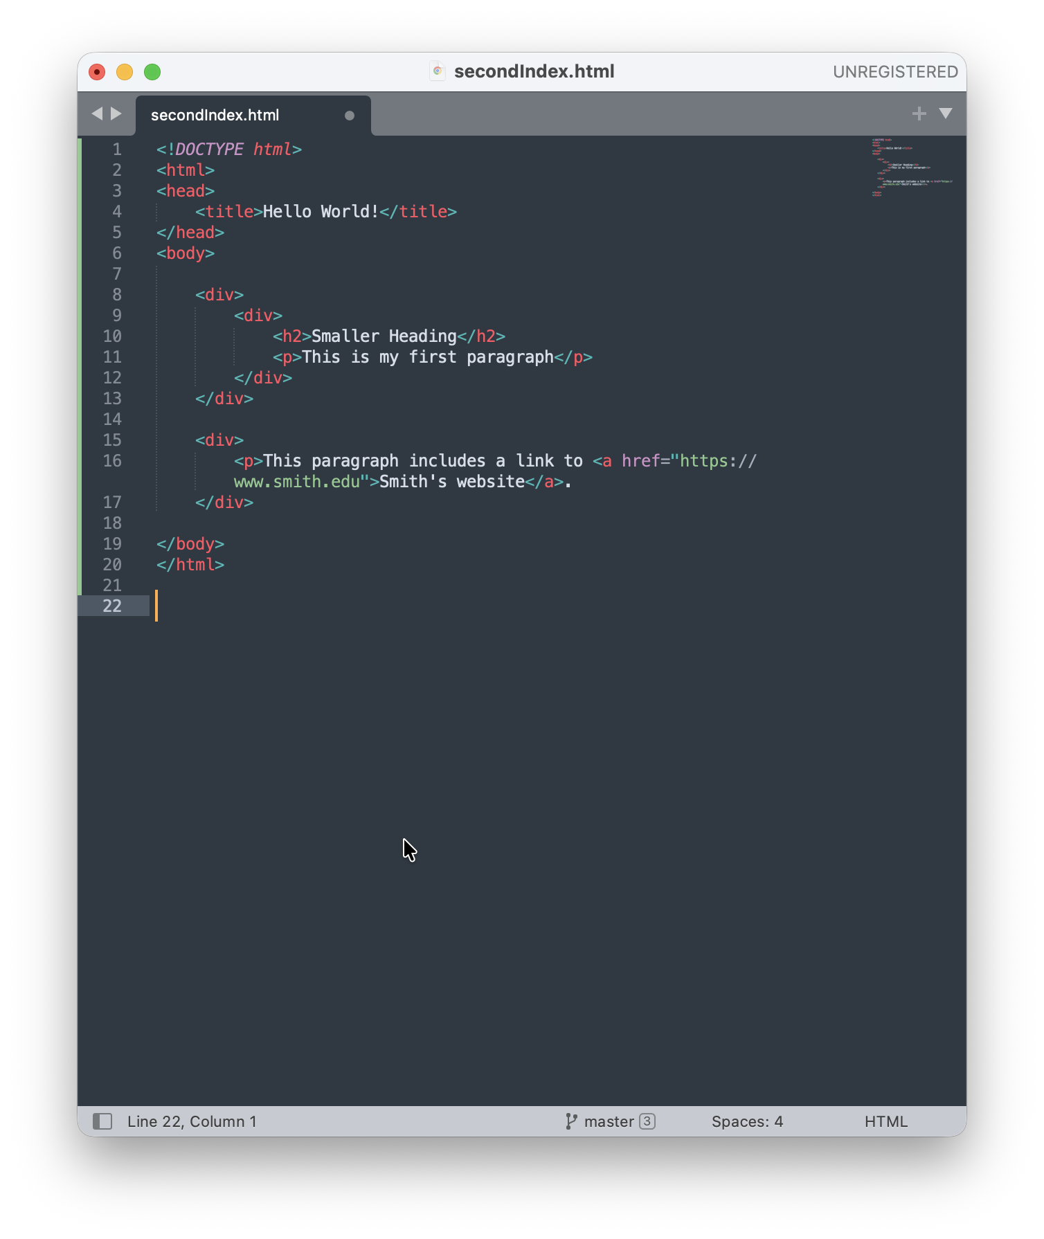
Building a webpage: HTML
Your turn: Draw the DOM for this webpage
https://www.w3schools.com/html/html_intro.asp

Slide 10
Building a webpage: HTML
The <!DOCTYPE html> declaration defines that this document is an HTML5 document
The <html> element is the root element of an HTML page
The <head> element contains meta information about the HTML page
The <title> element specifies a title for the HTML page (shown in the browser's title bar or in the page's tab)
The <body> element defines the document's body, and is a container for all the visible contents
The <h1> element defines a large heading
The <p> element defines a paragraph
Complete tag reference: https://www.w3schools.com/tags/default.asp
https://www.w3schools.com/html/html_intro.asp

Slide 11
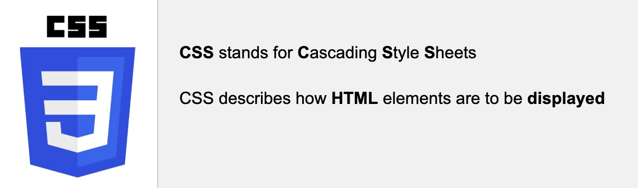
Styling a webpage: CSS
A webpage is styled through CSS
https://www.w3schools.com/html/html_intro.asp

Slide 12
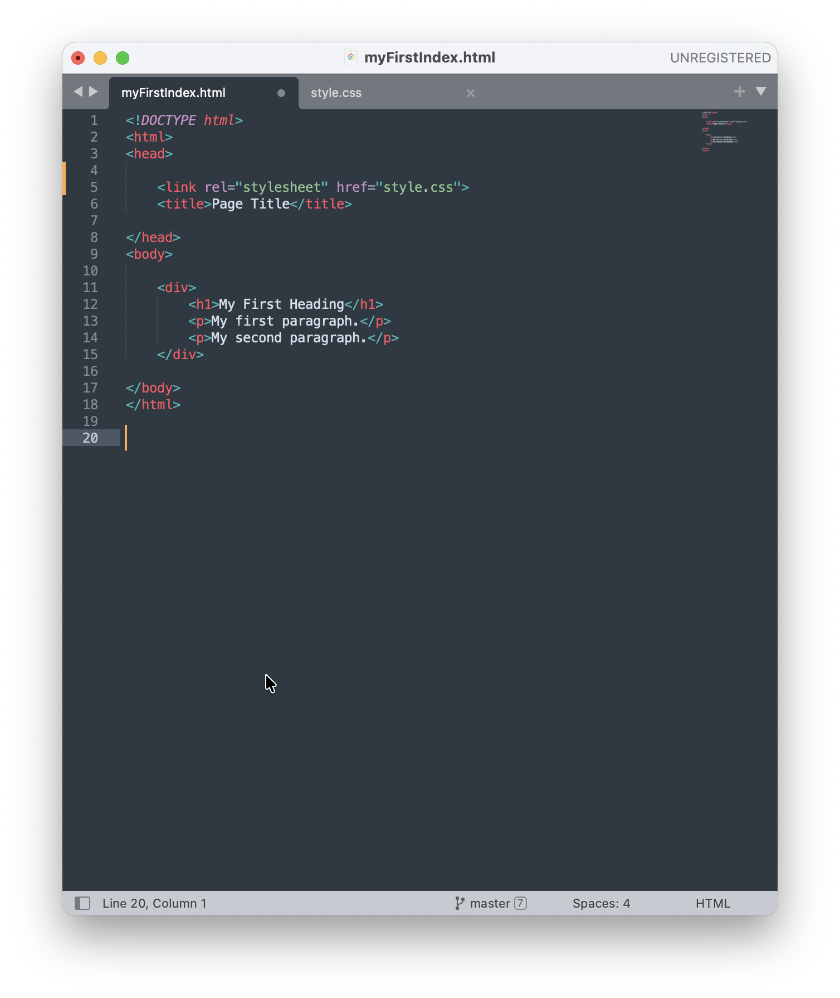
Styling a webpage: CSS
An HTML file is is linked to a CSS file
You can also style in-line
and with internal CSS, but
it is not best practice
https://www.w3schools.com/css/css_howto.asp

Slide 13
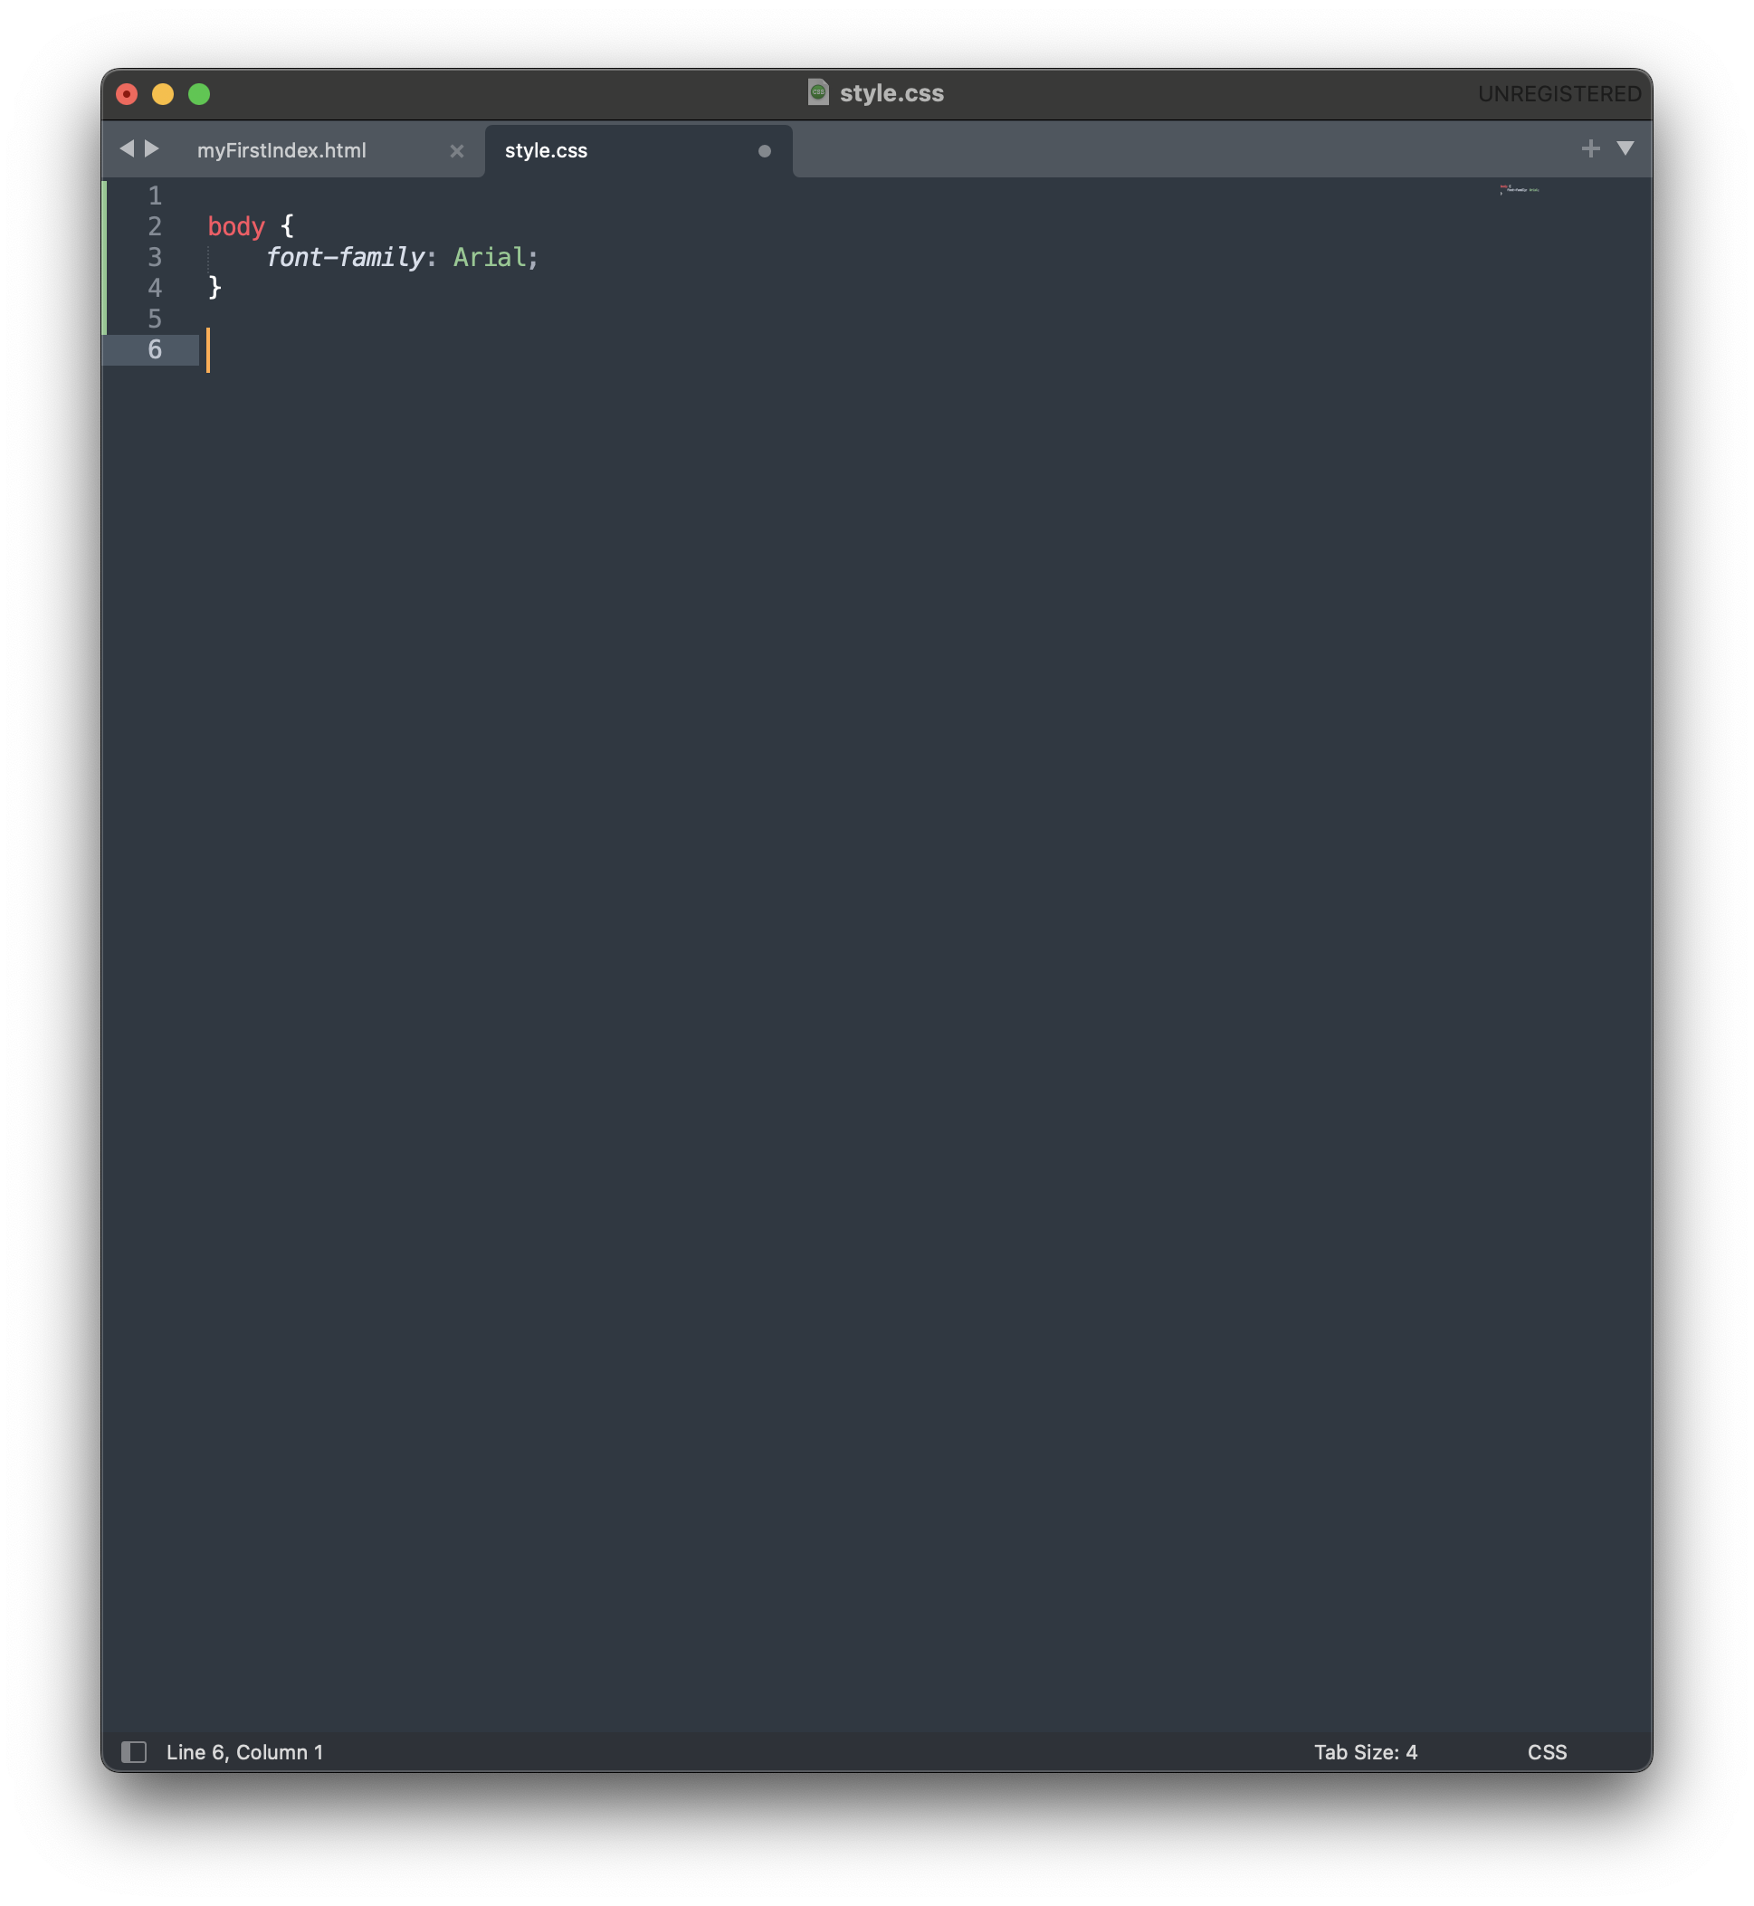
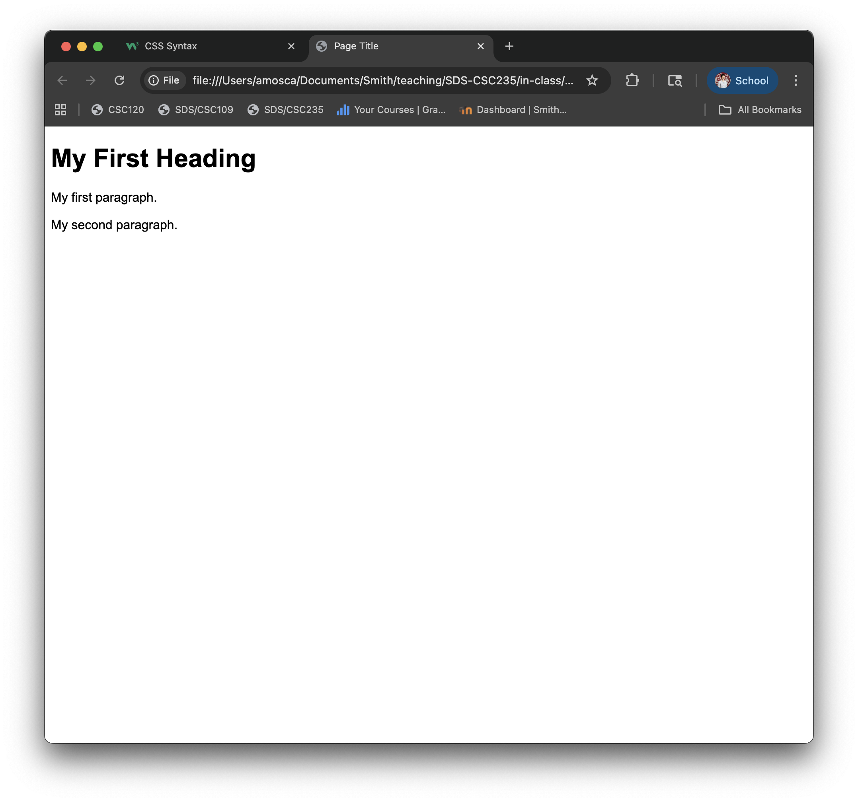
Styling a webpage: CSS
CSS files are sets of rules with specific syntax:
selector {
property : value;
property2 : value2;
…
}
https://www.w3schools.com/css/css_syntax.asp

Slide 14
Styling a webpage: CSS
A CSS selector can be an
element
The selector p indicates style for all paragraphs
class
An HTML element can be assigned a class
Ex. <h1 class=“title”>
The selector .title indicates style for all elements with class “title”
id
An HTML element can be assigned an id
Ex. <div id=“landing”>
The selector #landing indicates style for the element with id “landing”
https://www.w3schools.com/css/css_syntax.asp

Slide 15
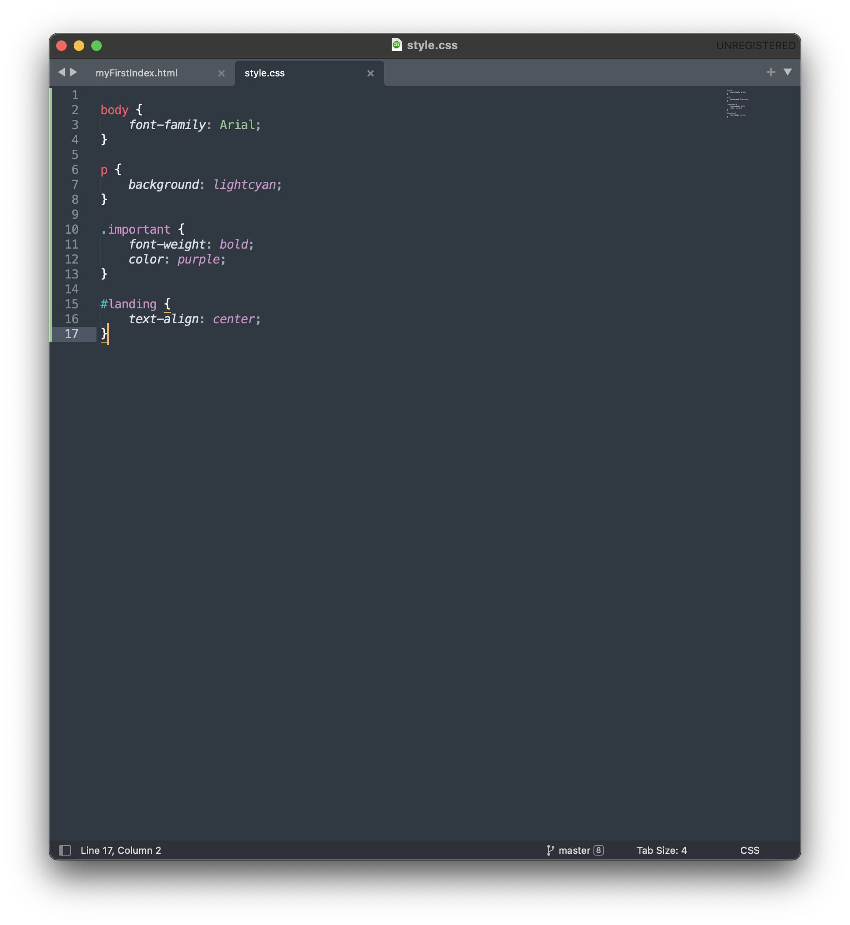
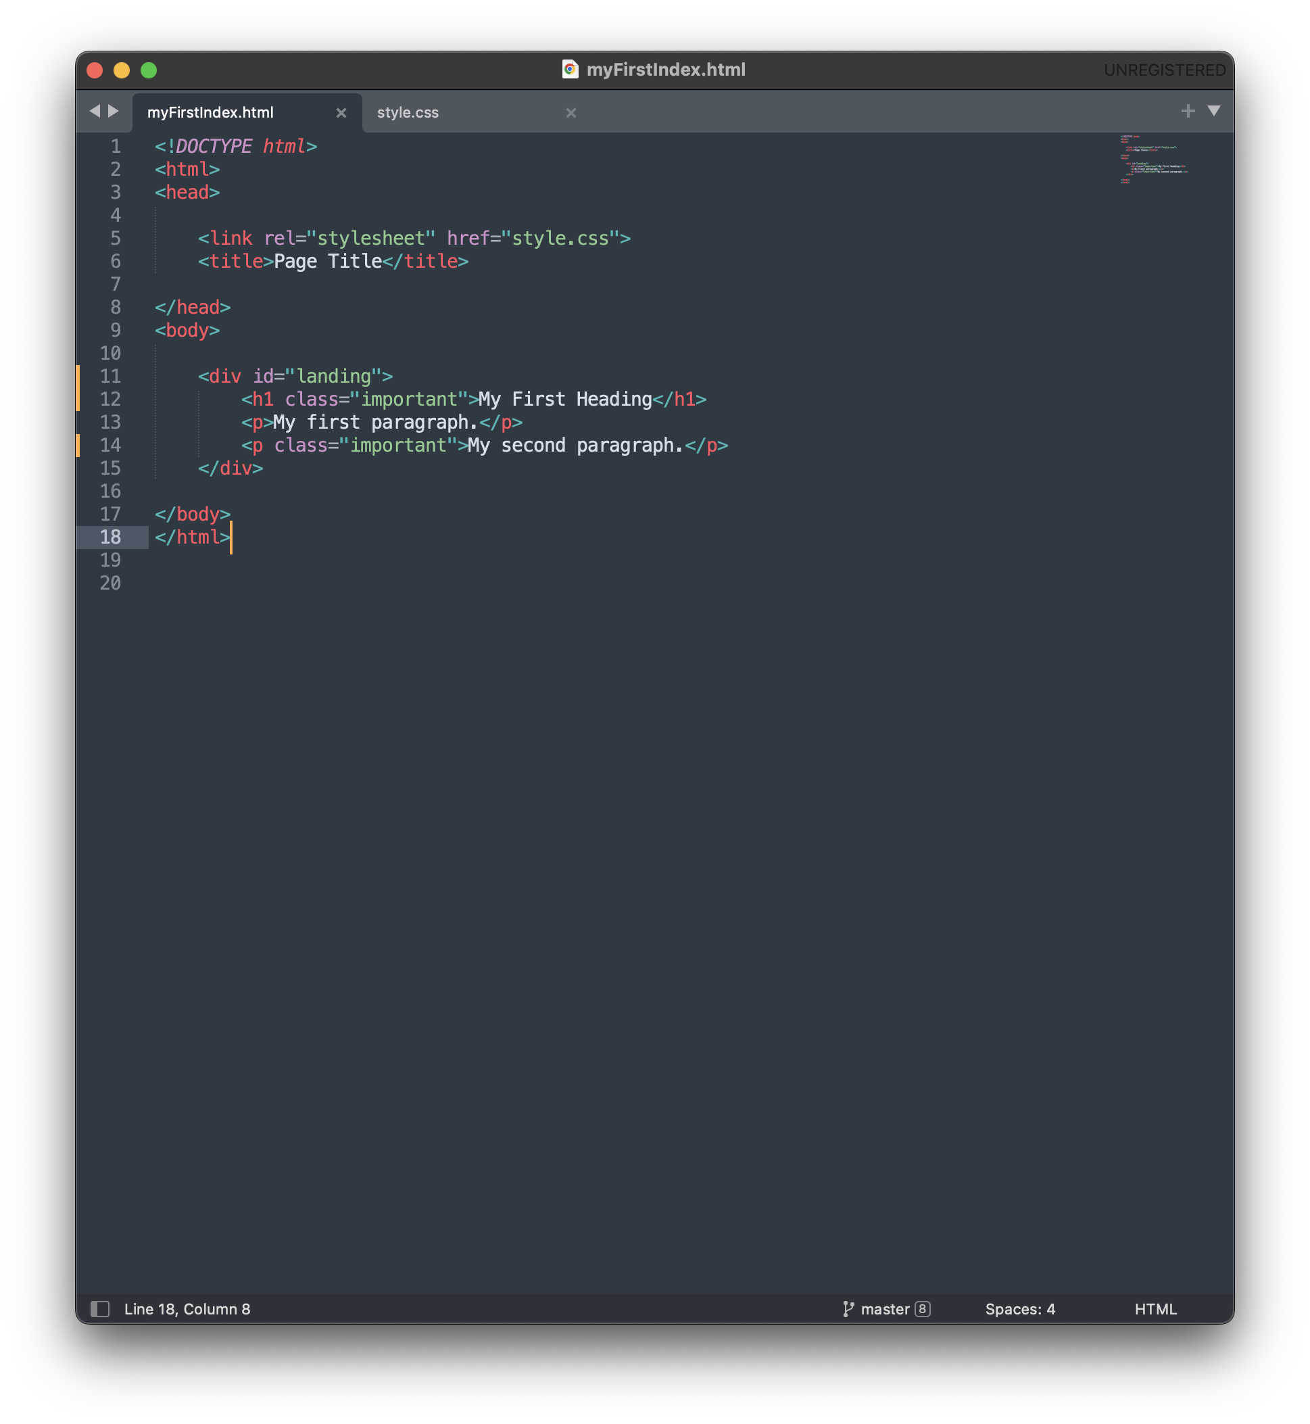
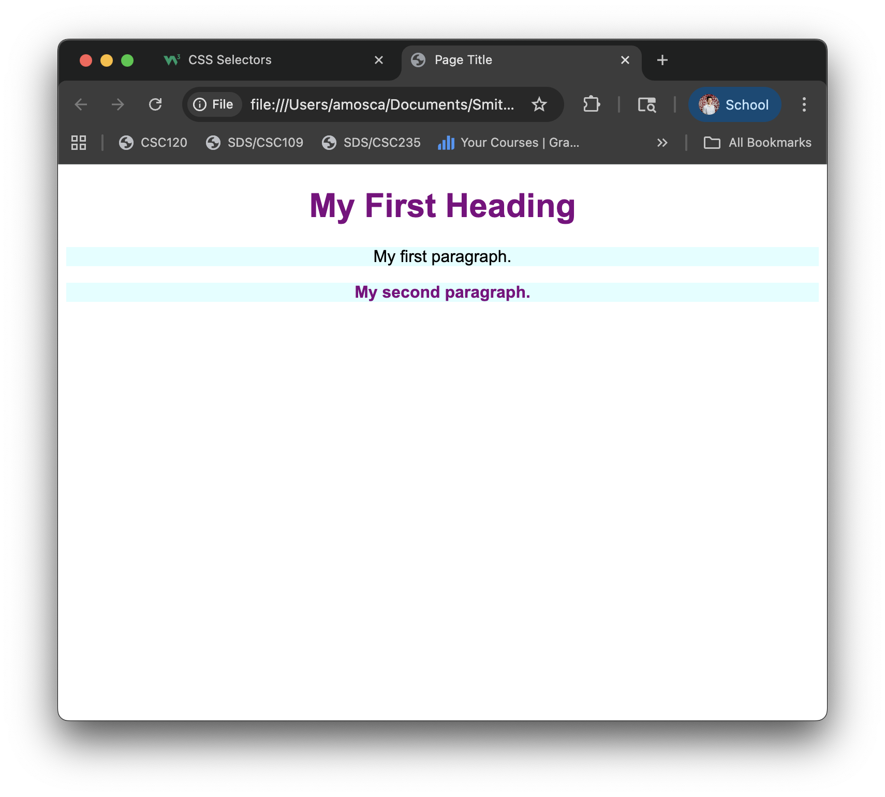
Styling a webpage: CSS

Slide 16
Styling a webpage: CSS
Your turn:
Modify the HTML in secondIndex.html and link an external CSS file to create a webpage that looks like this →
Helpful Resources:
https://www.w3schools.com/html/
https://www.w3schools.com/css/

